Slide 1
Documentation with GIT using Markdown
Jesse Driskill
July 9th, 2021
Notes:
Purpose: LM is used in place of the official licensing server to provide licenses to BIG-IP

Slide 2
What We Are Covering
Hint: still not everything
Using Markdown for nice looking documentation
Markdown syntax
Basic Github integration

Slide 3
Why?
Because jan doesn’t like me
BIG-IQ License Manager actually works pretty well
Take a look at Gregg’s Github project pages for some very approachable examples
https://github.com/grmarxer/Onboarding
Important note:
Several people on this call are far more experienced than I with Markdown. To those people I say, ”Be nice with your corrections”. I’m looking at you, Mr. Wells.

Slide 4
Markdown Basic Syntax

Slide 5
The Basics
Are syntax guides ever interesting?
Markdown allows you to focus more on the content rather than the formatting tags. Markdown allows the same flexibility as HTML, but with a simplified syntax that requires fewer characters to accomplish the same thing. A trivial example would be italicizing text. HTML requires wrapping the text in tags "<em>” and “</em>”, while Markdown accomplishes the same thing using asterisks (“*”).
Advantages
Fewer characters breaking up the actual text
More readable when the raw text is not interpreted, like in a basic text editor
More intuitive than HTML
HTML can be used within Markdown when native support isn’t present
Disadvantages
Duplicates existing HTML functionality

Slide 6
The Basics
nope
Trivial example:
HTML: <em>This text would be italicized</em>
Markdown: *This text would be italicized*

Slide 7
The Cheat Sheet
The most important item on this slide is the link
Trivial example:
HTML: <em>This text would be italicized</em>
Markdown: *This text would be italicized*
Real Cheat Sheet: https://www.markdownguide.org/basic-syntax#overview

Slide 8
Github + Markdown

Slide 9
Why?
Because jan doesn’t like me
BIG-IQ License Manager actually works pretty well
Take a look at Gregg’s Github project pages for some approachable examples
Important note:
Several people on this call are far more experienced than I with Markdown. To those people I say, ”Be gentle with your corrections”. I’m looking at you, Mr. Wells.

Slide 10
Syntax Guide

Slide 11
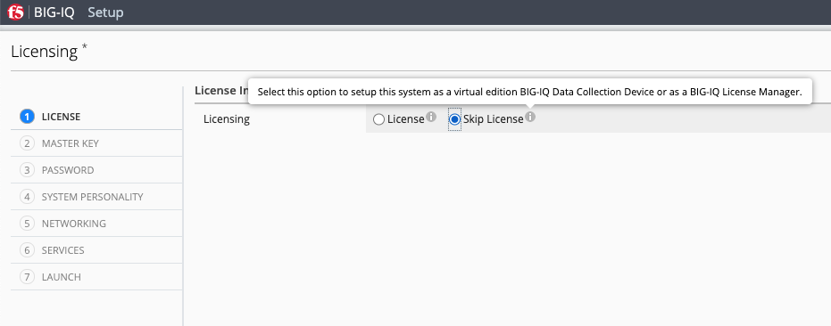
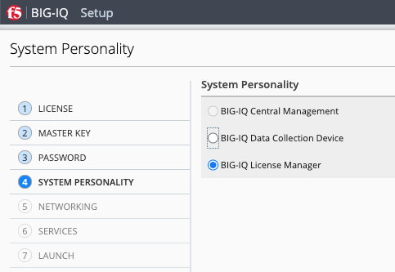
License Selection
License management is available with a full CM license, or by using the Skip License” option and the appropriate personality
The BIG-IQ shown in this presentation uses the Skip License option

Slide 12
Questions?
Expectation of Correct answers not expressed or implied

